Slide 1
Risk Culture Profiling Tool
An Introduction
October 2019

Slide 2
Agenda
Background - why the need?
The framework - structure and content
Practical uses, outputs and outcomes
Use and insights so far
Benefits Summary
What Next?

Slide 3
Why: Business Case & History

Slide 4
Why was a Risk Culture Profiling Tool needed?
RCPT
Traditional Focus on Operational Risk but
A + B = C - Attitudes + Behaviour = Culture
Can’t legislate for everything - move from rules to principles
Operational Risk Controls can partly impact behaviour via process, but less so, attitudes
Investment in layers of Inspection, Audit and Review, but still, claims that ‘shouldn’t happen’
Lots of theory and research on Culture but no (freely available) practical tools

Slide 5
Development Research
Various ERM and culture research papers and frameworks already in existence such as those by ISO, COSO, the FRC, the IRM etc.
QBE input from knowledge / insights from insurance claims and understanding of quality / business assurance models as a basis for managing risk
PRACTICAL EXPERIENCE
CURRENT RESEARCH
More recent research including items such as Airmic’s ‘Roads to Ruin’ and ‘Roads to Resilience’ etc
EXISTING FRAMEWORKS

Slide 6
Partnership with Airmic
Nov-15: RCPT launched at a QBE Design Risk event > seen by Airmic > requested use as basis for its own Guide on the Importance of Corporate Culture
Nov-16: Round table with Airmic members to review content and language to broaden appeal (Wellcome ~ Intu ~ John Lewis ~ FPS ~ Christies ~ Camelot ~ BP ~ Network Rail ~ BAE ~ Argo)
Jan-17: Launch of Airmic Guide to Corporate culture based on RCPT framework and clear reference to QBE and endorsement of RCPT
Jan-18: Airmic Academy event – feedback and revisions lead to launch of Version 2 (with greater emphasis on project / industrial aspects)

Slide 7
Risk Culture In the context of Good Governance
GUIDANCE:
“Boards should seek assurance about the health of the culture by taking the temperature of the organisation on a regular basis.
This means gathering evidence by monitoring chosen indicators, and assessing information from a range of company specific sources to gain insights into the overall culture”.
IMPACT: From January 2019, publicly listed (and now larger private organisations) must include culture in their annual reports
PROVISIONS:
“The board should assess and monitor culture.
Where it is not satisfied that policy, practices or behaviour throughout the business are aligned with the company’s purpose, values and strategy, it should seek reassurance that management has taken corrective action.”
The Financial Reporting Council (FRC) recently updated UK Corporate Governance Code (2018) states that:

Slide 8
What: The RCPT Framework

Slide 9
Framework for Evaluation: Risk Culture Profiling Tool
Key facts for the framework:
7 key areas
31 evaluations
1
Leadership
7
2
Continuous Improvement
People,
Training and
Development
Risk Culture
6
3
Performance Evaluation
Reward and Recognition
5s
4
Service Delivery / Operations Management
Communications

Slide 10
Framework for Evaluation
Leadership
  Positive risk ethos
  Embedded in strategy and planning
  Risk appetite and tolerance framework
  Leading by example
People, Training and Development
  Appropriate resources
  No-blame culture
  Accountability
  Monitoring buy-in
  Training and development support
  Evaluation of learning
  Understanding of approach
1
Leadership
7
2
Continuous Improvement
People,
Training and
Development
Organisational Culture
6
3
Performance Evaluation
Reward and Recognition
5
4
Service Delivery / Operations Management
Communications

Slide 11
Framework for Evaluation
Reward & Recognition
  Alignment of incentives
  No overpromising/mis-selling
  Part of performance review
Communications
  Visible across the organisation
  Stakeholder communications
  Sharing risk information
  Effective documentation
Operations
  Effective Compliance
  Assessing Controls
  Proactive Supervision
  Embedded Values
  Supply Chain Controls
1
Leadership
7
2
Continuous Improvement
People,
Training and
Development
Organisational Culture
6
3
Performance Evaluation
Reward and Recognition
5
4
Service Delivery / Operations Management
Communications

Slide 12
Framework for Evaluation
Product / Service Evaluation
  Effective control measures
  Customer feedback process
  Optimised learning
  Profitability and viability
Continuous Improvement
  MI to drive improvement
  Effective risk radar
  Emerging risks
  Demonstrating value
1
Leadership
7
2
Continuous Improvement
People,
Training and
Development
Organisational Culture
6
3
Performance Evaluation
Reward and Recognition
5
4
Operational
Communications

Slide 13
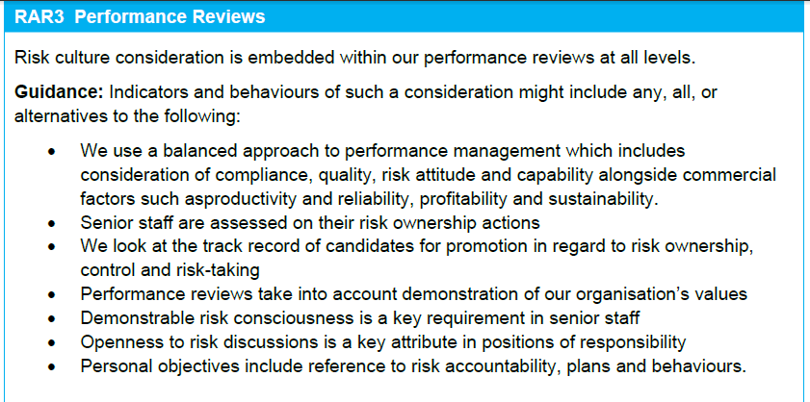
On QRisk: Example Evaluation with Indicators & Behaviours
Self-assessment
Scale of 1-7
Guided by indicators and behaviours
Or, can be facilitated (QBE Clients only)

Slide 14
How: Flexible Ways to Use

Slide 15


Uses & Flexibility of the Risk Culture Profiling Tool
QRisk for Benchmarking & Comparison
Before and/or after Mergers & Acquisitions
Comparison by Function, Division etc
Comparison of staff and management views
New / Revised Audit Focus
Thematic Review
High level ERM Review (Now & Future)
Comparison
by location

Slide 16
Qualitative & Quantitative Outputs

Slide 17
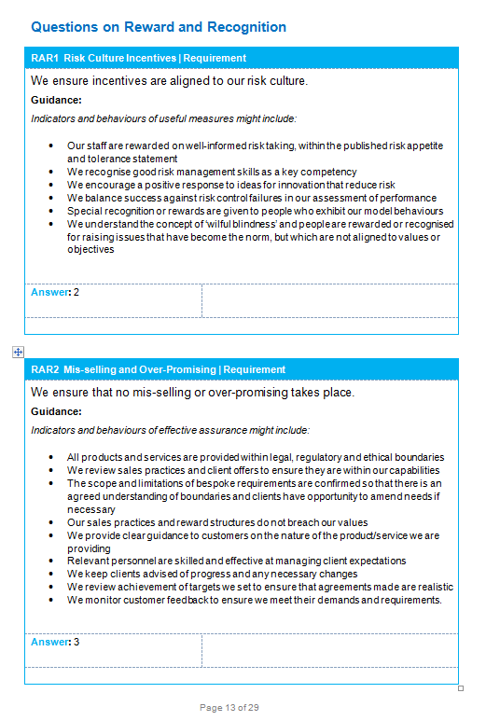
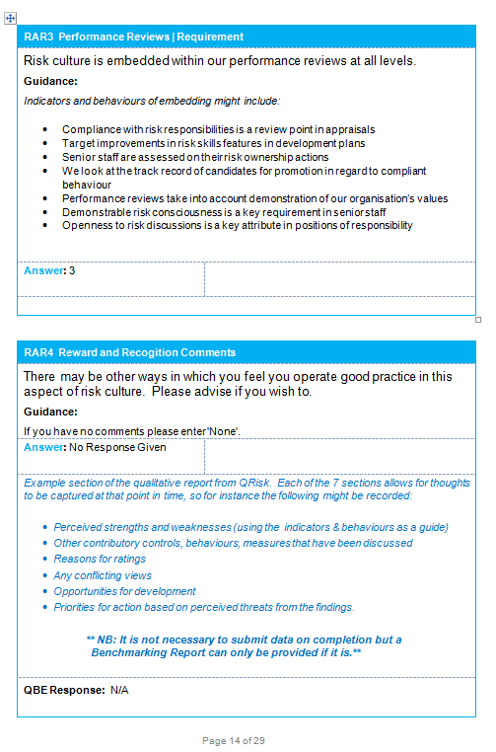
Example Report from QRisk

Slide 18
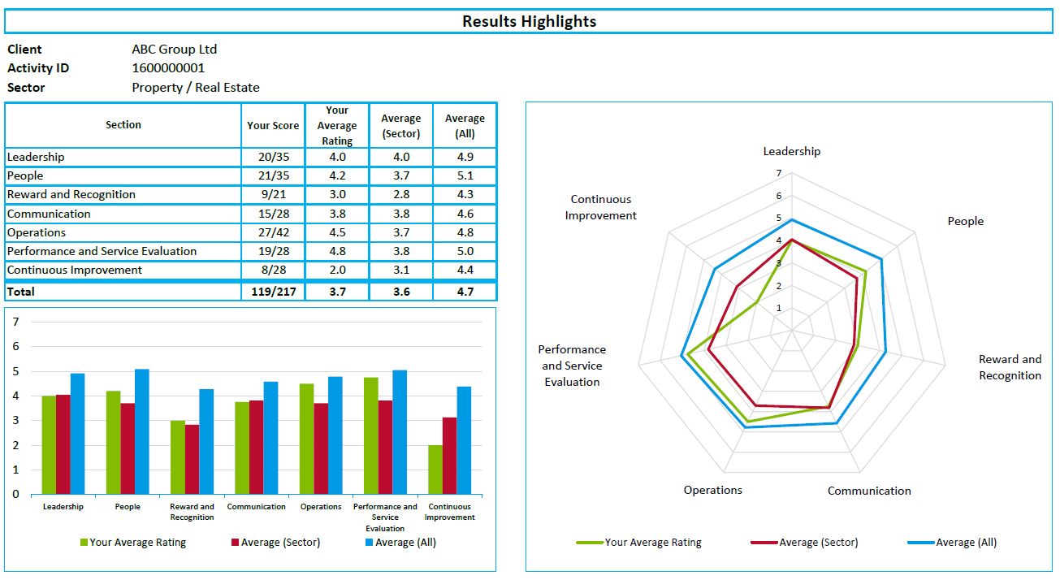
Example Benchmarking Report - Highlights
(Benchmarking can only be provided if data is submitted)

Slide 19
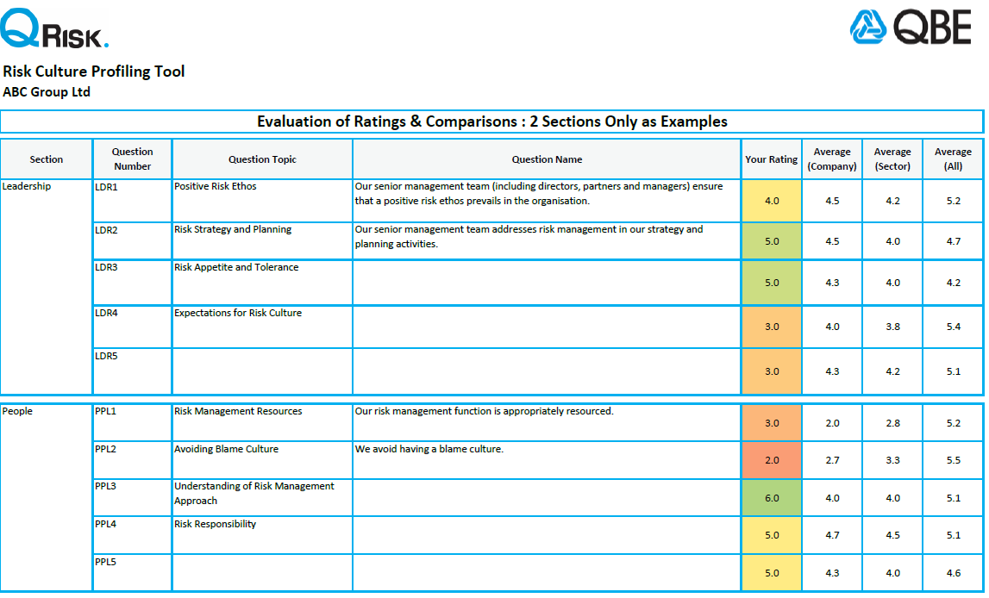
Example Benchmarking Report - Details

Slide 20
Insights so far

Slide 21
Highs & Lows by Section
Findings are based on 38 responses across a range of sectors including:
Architecture, Engineering, Legal, Healthcare, Retail, Facilities Management, Transportation, Financial Services, Real Estate, IT Security, Leisure, Not-for-Profit
Stronger Aspects:
Performance / Service Evaluation
People, Training & Education
Weaker Aspects:
Reward & Recognition
Continuous Improvement

Slide 22
Highs & Lows : Individual Evaluations
Lowest Rated
Highest Rated
3.5
We ensure incentives are aligned to our risk culture and values
3.9
Risk culture is embedded within our performance reviews at all levels
4.2
We demonstrate the value of our continuous improvement activities
5.4
We avoid having a blame culture
5.2
Our SMT demonstrates adherence to the same expectations for integrity, risk culture & governance as all others
5.1=
Positive risk ethos; Embedded core values in operations; Embedded risk culture in operations
As at Sep-19, self-assessed on scale of 1-7. Based on 38 organisations across the following sectors: Architecture, Engineering, Legal, Healthcare, Retail, Facilities Management, Transportation, Financial Services, Real Estate, IT Security, Leisure, Not-for-Profit.

Slide 23
Key Benefits

Slide 24
Benefits Summary
Cost-effective: ready-made and comprehensive framework for evaluation
Generic: use in any type of business
Collaborative: Involves senior management & fosters debate
Flexible: use at organisational level only or to compare locations, functions, views or business within a group
Demonstrates commitment: to improvement to stakeholders (including compliance with or steps towards Codes & Standards)
Reference data: qualitative, quantitative, and benchmarking
Signposts to next steps: For example Governance / Board effectiveness, Process Review, Incidents Review and Organisational Learning

Slide 25
Any Questions?
Resources & Support
Blogs, News, Webinars, Service Summary etc.
is all hosted on the dedicated
Risk Culture Microsite
https://qbeeurope.com/rc
Airmic Members request via
https://www.airmic.com/risk-culture-profiling-tool

